Slide 1
Ontario's Fair Hydro Plan:
Providing Relief for Consumers
Technical Briefing
Ontario Ministry of Energy
March 2, 2017

Slide 2
Outline of Technical Briefing
Overview of Ontario’s Electricity Market
Ontario’s Fair Hydro Plan – Providing Relief for Consumers
Questions

Slide 3
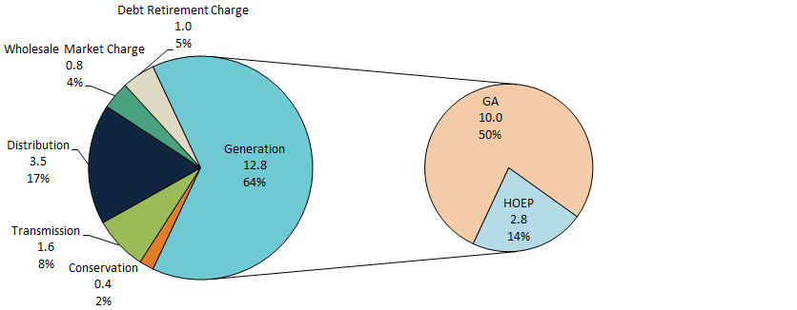
Ontario’s Electricity Market
In 2015, generation accounted for 64% of total electricity system costs. Total system costs in 2015 were $20 billion.
2015 Electricity System Cost
$ billion
Source: IESO

Slide 4
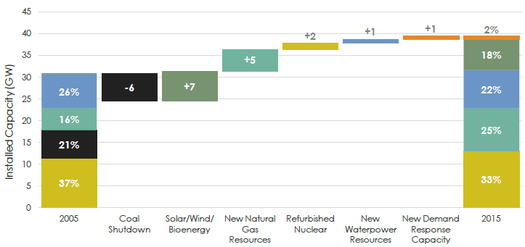
Significant Change in Supply Mix
Between 2005 and 2015, government invested more than $50 billion in the electricity system, including $35 billion in electricity generation to restore reliability, replace coal and meet environmental objectives.
  Electricity costs are increasing as necessary investments are made to decarbonize and modernize the province’s electricity infrastructure.
Source: IESO

Slide 5
Electricity Prices Have Increased
Since 2010, electricity prices have increased at a rate higher than the Consumer Price Index (CPI).
Source: Ministry of Energy

Slide 6
Recent Actions To Mitigate Electricity Rates
Following the 2016 Throne Speech, several actions were announced to further reduce electricity costs.
  As of January 1, 2017, Ontario is rebating an amount equal to the provincial portion of the HST to reduce eligible residential, small business and farm electricity bills by 8%.
  Expanded support available to eligible rural ratepayers by updating Rural or Remote Rate Protection (RRRP) with additional relief, decreasing total electricity bills by an average of $45 each month when combined with the 8% rebate.
  Expanding the Industrial Conservation Initiative (ICI) – up to one-third savings for participants.
  Suspending the LRP II and the Energy from Waste Standard Offer Program (EFWSOP) – up to $3.8 billion in cost savings.
  Limiting the Feed-In Tariff (FIT) 5 procurement target to 150 MW and suspending future FIT procurements – up to $129 million in cost savings.

Slide 7
Ontario’s Fair Hydro Plan

Slide 8
Ontario’s Fair Hydro Plan
Ontario is lowering electricity bills by 25 per cent for the typical residential customer and holding rate increases to the rate of inflation for four years. Small businesses and farms would also benefit from this initiative.
People with low incomes, those served by local distribution companies (LDCs) with the highest distribution costs, OESP recipients and On-Reserve First Nation households would benefit from even greater reductions to their electricity bills.
These new measures will cost the government up to $2.5 billion over the next three years.
Government intends to introduce legislation to enable Ontario’s Fair Hydro Plan.

Slide 9
Refinancing Global Adjustment

Slide 10
Refinancing the Global Adjustment
Refinancing the Global Adjustment (GA) would provide significant and immediate rate relief by spreading the cost of electricity investments over a longer period of time.
  25% reduction on average for the typical residential customer and rates would follow inflation for the next 4 years.
Under current forecasts, the immediate reduction (i.e., the financed portion) in the GA would be about $2.5 billion per year on average over the first ten years, with a maximum annual interest cost of $1.4 billion.
This measure would share the associated costs more fairly. The chart below shows how Global Adjustment (GA) cost is front-end loaded and forecast to decline over time.
Forecast Global Adjustment Cost (nominal $ million)
Source: IESO

Slide 11
Policy Rationale
The majority of the province’s electricity generators are under 20-year contracts. Many of these generators will be able to operate past their contract term.
By recognizing that generation assets are expected to continue to provide benefit to future ratepayers, beyond the term of current contracts, future ratepayers are expected to be able to utilize these assets and reduce the need to finance the development of new generation assets.
In the early years, a portion of the costs covered by the GA would be financed to reduce pressure on electricity ratepayers.
In the later years, when some system costs are expected to be reduced due to continued operation of existing assets under 20-year contracts, the cost of financing would be recovered from ratepayers.
“The amount consumers pay today could be reduced by stretching capital amortization periods to match the expected productive lives of the assets. In this way, the costs of generation charged to households would more closely reflect the true economic costs of the assets.”
Globe and Mail Op-Ed (February 28, 2017) – Ivey Business School

Slide 12
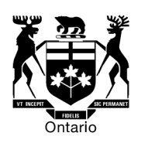


Implementation
The following entities would implement the proposed Global Adjustment (GA) refinancing mechanism.
  The government intends to introduce legislation that would, if passed, enable IESO and OPG to work together to refinance the GA over a longer period of time. The legislation would also outline the role for the OEB, as it relates to the financing proposal.
Ontario Energy Board (OEB)
Independent
Electricity
System Operator
Electricity Consumers
Through
LDCs
Lowered payments for
generation in the short term
Finances/ Manages GA proposal
Settles electricity market transactions with generators and consumers
Generators
Unaffected by proposal

Slide 13
Helping Vulnerable Consumers

Slide 14
Helping Vulnerable Electricity Consumers
Fair Hydro Plan initiatives to help vulnerable consumers include:
  Broadening Rural or Remote Rate Protection (RRRP) program to provide distribution charge relief for the customers of the costliest local distribution companies (LDCs).
  Enhancing the Ontario Electricity Support Program (OESP) and working to ensure the program uptake is as close as possible to 100%.
  Establishing a new First Nations On-Reserve Delivery Credit.
  Establishing a new Affordability Fund which would support Ontarians who have difficulty paying their electricity bills to be able to access energy efficiency improvements.
All of these initiatives would provide benefits to eligible consumers on top of the benefits they would receive from Global Adjustment (GA) refinancing.
As part of the Fair Hydro Plan, these programs would be funded by provincial revenues, reducing regulatory charges for all Ontario ratepayers.
  These programs would be funded by provincial revenues because they all provide targeted benefits to vulnerable consumers.

Slide 15
Broadening Rural or Remote Electricity Rate Protection (RRRP)
Rural or Remote Rate Protection (RRRP) provides a rate subsidy to rural or remote residential customers who are faced with higher distribution costs compared to urban areas.
  The RRRP is currently provided to approximately 350,000 Hydro One R2 residential customers in Ontario.
The Province would expand the RRRP to provide distribution charge relief to additional hydro customers served by local distribution companies (LDCs) with the highest distribution rates, including: Hydro One R1, Northern Ontario Wires Inc., Lakeland Parry Sound, Chapleau PUC, Sioux Lookout Hydro, InnPower, Atikokan Hydro and Algoma Power. This would extend RRRP availability to about 800,000 customers.
The new benefits would vary from LDC to LDC. For example:
  A Hydro One R2 customer consuming 2,500kWh a month would see distribution cost reductions of around $75 a month.
  A Hydro One R1 customer consuming 1,000kWh a month would see distribution cost reductions of around $18 a month.
  An InnPower customer consuming 1,000kWh a month would see distribution cost reductions of around $12 a month.
The government intends to introduce legislation to broaden the RRRP and to move forward in having RRRP costs be funded by provincial revenues, reducing regulatory charges for all Ontario ratepayers.

Slide 16
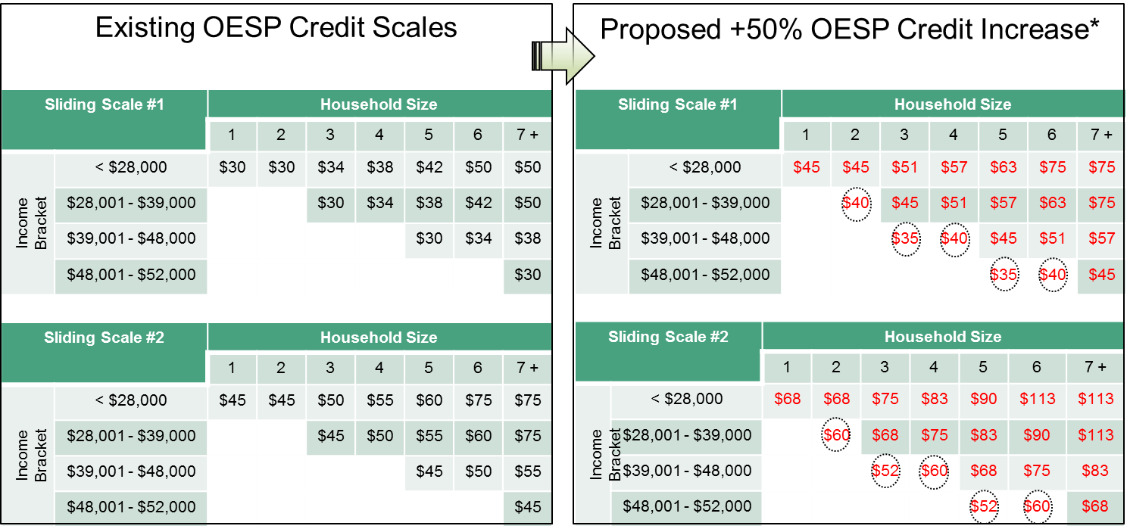
Enhancing the Ontario Electricity Support Program (OESP)
The OESP would be enhanced by increasing its monthly credits by 50%, expanded to cover more low-income Ontarians, and increasing uptake to as close to 100% as possible.
  Sliding Scale #1 outlines basic program benefits, and Sliding Scale #2 outlines enhanced benefits for Indigenous households, electrically heated households, and households with certain medically intensive medical equipment.
The government intends to introduce legislation to enhance the OESP and to move forward in having OESP costs be funded by provincial revenues, reducing regulatory charges for all Ontario ratepayers.
*Note: The proposed higher scale, including the amounts in circles are proposed and will be refined in consultation with the OEB.

Slide 17
First Nations On-Reserve Delivery Credit
In 2016, the Minister of Energy asked the Ontario Energy Board (OEB) to develop options for a First Nation delivery credit for households.
The OEB, engaging with First Nations, including remote communities, the distributors serving them, and consumer groups, developed the following recommendations:
  Eliminating the delivery charge for all on-reserve First Nations households and removing the monthly service charge for customers of licensed distributors which charge a bundled rate. The OEB estimates this would provide residential customers an average monthly benefit of $85.
  Automatically qualify on-reserve First Nations households (~21,500 customers).
The government intends to introduce legislation to create the First Nations On-Reserve Delivery Credit and to move forward in having its costs be funded by provincial revenues, reducing regulatory charges for all Ontario ratepayers.

Slide 18
Establishing a New Affordability Fund
The Affordability Fund would assist electricity customers who cannot qualify for low-income conservation programs and need financial assistance to undertake energy efficiency improvements.
The Affordability Fund would provide LDCs with an additional tool to help customers in need. LDCs would use the Fund to provide support to customers for energy efficiency improvements to help reduce their future electricity bills.
Measures supported by the Fund are expected to be similar to those available under the existing low-income conservation program, such as energy efficient lighting and appliances and, for electrically heated homes, insulation and weather stripping. Cold climate air source heat pumps would also be an eligible measure.
The Province intends to work with Hydro One, in consultation with all other LDCs, to establish an independent Trust to serve as the administrator of the Affordability Fund.
The Province would pay for the Fund through provincial revenues.

Slide 19
Enhancing Competitiveness for Small Manufacturers and Industrials

Slide 20
Enhancing Competitiveness for Small Manufacturers and Industrials
The Industrial Conservation Initiative (ICI) provides a strong incentive for participating consumers to reduce their consumption during peak hours to reduce their costs.
Expanding the eligibility threshold for the ICI would provide small manufacturers and industrials the opportunity to save on their electricity costs, while reducing the province’s peak demand. The expanded ICI would include
  Extending eligibility to small manufacturers and industrials with average monthly peak demand over 500 kilowatts; and
  Targeting eligibility to energy intensive industries with the North American Industry Classification System (NAICS) codes 31 - 33 (i.e., Manufacturing).
Under the expanded ICI, small manufacturers and industrials whose electricity demand is currently too low to qualify for ICI, would now be eligible for the expanded ICI if they wish to participate.
Small manufacturers would also benefit from funding social programs through provincial revenues.
In addition, the Ministry would assist small manufacturers and industrials’ participation in ICI through a targeted outreach campaign delivered by the Ontario Chamber of Commerce (OCC).

Slide 21
Market Efficiencies / Bending the Cost Curve

Slide 22
Ongoing Efforts To Bend The Cost Curve of Ontario’s Electricity System
Since 2010, the government has taken a number of important actions to reduce electricity system costs, including:
  Renegotiating the Green Energy Investment Agreement to reduce contract costs by $3.7 billion.
  Reducing Feed-In Tariff (FIT) prices saving ratepayers at least $1.9 billion.
  Introducing a competitive Large Renewable Procurement (LRP) process to drive down costs approximately $1.5 billion lower than the 2013 LTEP forecast.
  Deferring the construction of two new nuclear reactors at Darlington, avoiding an estimated $15 billion in new construction costs.
  Maximizing the value of our existing nuclear fleet by starting Bruce refurbishments in 2020 instead of 2016, thus helping to achieve $1.7 billion in savings and by continuing to operate Pickering up to 2024, pending regulatory approvals, which could save ratepayers about $600 million.

Slide 23
Improving Electricity Sector Efficiency
The Ontario Energy Board (OEB)
  The Ontario Energy Board (OEB) regulates and licences more than 70 Local Distribution Companies (LDCs) in the province. The OEB would identify opportunities for cost efficiencies by:
  Encouraging shared partnerships on services between utilities, which will help reduce costs and encourage further innovation for small to medium sized utilities;
  Reviewing regulatory requirements to reduce “red tape” and eliminate unnecessary costs on LDCs; and
  Looking at opportunities to further drive transmitter and LDC efficiencies and productivity improvements, including the use of innovative technologies and business processes.
Independent Electricity System Operator
  The IESO plans for the province’s electricity needs, balances the supply and demand for electricity in Ontario in real time and administers conservation programs.
  The IESO’s Market Renewal includes such initiatives as developing a capacity auction process, introducing a day-ahead energy market, etc.
  Changes related to IESO’s Market Renewal initiatives are estimated to save at least $200 million per year, starting in 2021.

Slide 24


2017 Long-Term Energy Plan
The Ministry of Energy is developing the next Long-Term Energy Plan (LTEP) after receiving feedback from the public, stakeholders and indigenous communities during the engagement process that took place from October to January 2017.
The LTEP process is designed to be iterative and flexible and only commit resources as demand needs become clearer.
The Ministry of Energy anticipates that the next LTEP will be published in spring 2017.

