Slide 1
Ontario's Fair Hydro Plan
Technical Briefing
March 2017
Working Draft

Slide 2
Outline of Technical Briefing
Overview of Ontario’s Electricity Market
Fair Hydro Plan
Questions

Slide 3
Ontario’s Electricity Market
In 2015, generation accounted for 64% of total electricity system costs.
2015 Electricity System Cost
$ billion
Source: IESO

Slide 4
Commodity Cost of Electricity
  Electricity generators in Ontario received contracted or regulated rates, which are designed to recover the cost of building and operating generation facilities.
    The Hourly Ontario Energy Price (HOEP) is the hour-by-hour market clearing price that reflects the short-term cost of producing power.
    The Global Adjustment (GA) recovers the long-term fixed costs of operating the province’s generation fleet, including capital costs, as well as the cost of conservation programs.
2015 Electricity System Cost
$ billion
Source: IESO

Slide 5
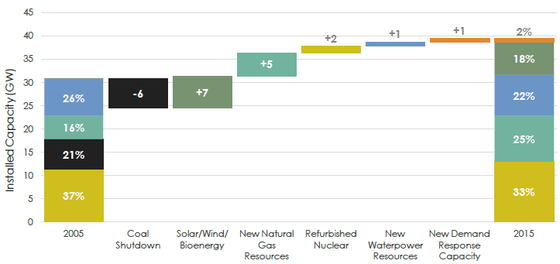
Significant Change in Supply Mix
Between 2005 and 2015, government invested more than $50 billion in the electricity system, including $35 billion in electricity generation to restore reliability, replace coal and meet environmental objectives.
  Electricity costs are increasing as necessary investments are made to decarbonize and modernize the province’s electricity infrastructure.
Source: IESO

Slide 6
Electricity Prices Have Increased
Since 2010, electricity prices have increased at a rate higher than the Consumer Price Index (CPI).
Source: Ministry of Energy

Slide 7
Recent Actions To Mitigate Electricity Rates
Following the 2016 Throne Speech, the several actions were announced to further reduce electricity costs.
  As of January 1, 2017, Ontario is rebating an amount equal to the provincial portion of the HST to reduce eligible residential, small business and farm electricity bills by 8%.
  Expanded support available to eligible rural ratepayers by updating Rural or Remote Rate Protection (RRRP) with additional relief, decreasing total electricity bills by an average of $45 each month when combined with the 8% rebate.
  Expanding the Industrial Conservation Initiative (ICI) – up to one-third savings for participants.
  Suspending the LRP II and the Energy from Waste Standard Offer Program (EFWSOP) – up to $3.8 billion in cost savings.
  Limiting the Feed-In Tariff (FIT) 5 procurement target to 150 MW and suspending future FIT procurements – up to $129 million in cost savings.

Slide 8
Fair Hydro Plan

Slide 9
Fair Hydro Plan
The Fair Hydro Plan has the following major components:
  Refinancing the Global Adjustment (GA) over a longer time period for Regulated Price Plan (RPP) eligible consumers, including families, farms and small businesses.
  Helping vulnerable electricity consumers by enhancing electricity support and conservation programs, and funding these programs from provincial revenues.
    Establishing a new Affordability Fund which will support Ontarians who have difficulty paying their electricity bills to be able to access energy efficiency improvements.
    Broadening Rural or Remote Rate Protection (RRRP) to provide distribution charge relief for the customers of the costliest local distribution companies (LDC’s).
    Enhancing the Ontario Electricity Support Program (OESP) and working to ensure the program uptake is as close as possible to 100%.
    Establishing a new First Nations On-Reserve Delivery Credit.
    Enhancing competitiveness for small manufacturers and industrials by lowering the eligibility threshold for Industrial Conservation Initiative (ICI).
Improving sector efficiency and modernizing Ontario’s electricity market, working in collaboration with the Independent Electricity System Operator (IESO) and the Ontario Energy Board (OEB).

Slide 10
Refinancing Global Adjustment

Slide 11
Refinancing the Global Adjustment
Refinancing the Global Adjustment (GA) will provide significant and immediate rate relief by spreading the cost of electricity investments over a longer period of time.
  A typical Toronto Hydro consumer, using 750 kWh per month, would see an immediate savings of about $26/month. Rates would follow inflation for 4 years, before increasing to repay financed GA costs.
In the early years, a portion of the costs covered by the GA would be financed to reduce pressure on electricity ratepayers.
In the later years, when some system costs are expected to be reduced due to continued operation of existing assets under 20-year contracts, the cost of financing would be recovered from ratepayers.
Under current forecasts, the immediate reduction (i.e., the financed portion) in the GA would be about $2.5 billion per year on average over the first ten years, for a total accumulated debt of about $28 billion on a forecast basis.

Slide 12
Policy Rationale
The majority of the province’s electricity generators are under 20-year contracts. Many of these generators will be able to operate past their contract life.
By recognizing that generation assets are expected to continue to provide benefit to future ratepayers, beyond the term of current contracts, future ratepayers are expected to be able to utilize these assets and reduce the need to finance the development of new generation assets.
This measure will share the associated costs more fairly. The chart below shows how Global Adjustment (GA) cost is forecast to decline over time.
Forecast Global Adjustment Cost (nominal $ million)
Source: IESO

Slide 13
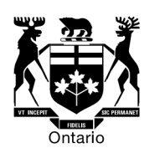


Implementation
The following entities would implement the proposed Global Adjustment (GA) refinancing mechanism.
  The government intends to introduce legislation that would, if passed, enable IESO and OPG to work together to refinance the GA over a longer period of time. The legislation would also outline the role for the OEB.
Ontario Energy Board (OEB)
Independent
Electricity
System Operator
Electricity Consumers
Lowered payments for
generation in the short term
Acquires regulatory asset and finances GA proposal
Creates regulatory asset
Generators
Unaffected by proposal

Slide 14
Helping Vulnerable Consumers

Slide 15
Helping Vulnerable Electricity Consumers
Initiatives to help vulnerable consumers:
  Broadening Rural or Remote Rate Protection (RRRP) to provide distribution charge relief for the customers of the costliest local distribution companies (LDCs).
  Enhancing the Ontario Electricity Support Program (OESP) and working to ensure the program uptake is as close as possible to 100%.
  Establishing a new First Nations On-Reserve Delivery Credit.
  Establishing a new Affordability Fund which will support Ontarians who have difficulty paying their electricity bills to be able to access energy efficiency improvements.

Slide 16
Broadening Rural or Remote Electricity Rate Protection (RRRP)
Rural or Remote Rate Protection (RRRP) provides a rate subsidy to rural and remote residential customers who are faced with higher distribution costs compared to urban areas.
  The RRRP is currently provided to approximately 350,000 Hydro One R2 residential customers in Ontario.
The Province will expand the RRRP to provide distribution charge relief to additional hydro customers served by local distribution companies (LDCs) with the highest distribution rates, including: Hydro One R1, Northern Ontario Wires, Lakeland Parry Sound, Chapleau, Sioux Lookout Hydro, InnPower, Atikokan Hydro and Algoma Power.
The new benefits would vary from LDC to LDC. For example:
  A Hydro One R2 customer consuming 2,500kWh a month would see distribution cost reductions of around $75 a month.
  A Hydro One R1 customer consuming 1,000kWh a month would see distribution cost reductions of around $18 a month.
  An InnPower customer consuming 1,000kWh a month would see distribution cost reductions of around $12 a month.
The Province is also moving forward in having these RRRP costs be funded by provincial revenues, reducing regulatory charges for all Ontario ratepayers.
  This is projected to cost approximately $500 million in the coming fiscal year.

Slide 17
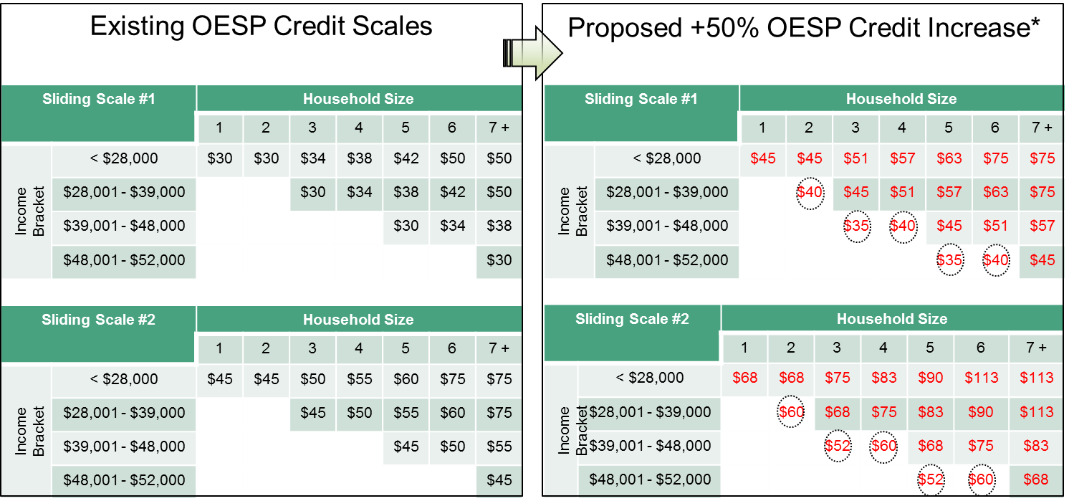
Enhancing the Ontario Electricity Support Program (OESP)
The OESP would be enhanced by increasing its existing credit amounts by 50% and be expanded to cover more low-income Ontarians.
The province will work to increase OESP uptake to as close to 100% as possible.

Slide 18
First Nations On-Reserve Delivery Credit
In 2016, the Minister of Energy asked to Ontario Energy Board (OEB) to develop options for a First Nation delivery credit for households.
The OEB, engaging with First Nations, including remote communities, the distributors serving them, and consumer groups such as the Low Income Energy Network developed the following recommendations:
  Eliminating the delivery charge for all on-reserve First Nations households and removing the monthly service charge for customers of licensed distributors which charge a bundled rate. The OEB estimates this would provide residential customers an average monthly benefit of $85.
  Automatically qualify on-reserve First Nations households (~21,500 customers).
The Province plans to move forward in implementing the First Nations On-Reserve Delivery Credit, including funding it through provincial revenues to avoid increasing regulatory charges for all Ontario ratepayers.
  This is projected to cost approximately $20 million in the coming fiscal year.

Slide 19
Establishing a New Affordability Fund
The Affordability Fund will assist electricity customers who cannot qualify for low-income conservation programs.
The Affordability Fund will provide LDCs with an additional tool to help customers in need. LDCs will use the Fund to provide support to customers for energy efficiency improvements to help reduce their future electricity bills.
The Province will work with Hydro One, in consultation with all other LDCs, to establish an independent Trust to serve as the administrator of the Affordability Fund.
The Province will pay for the Fund through provincial revenues. This is projected to cost $200 million in the current fiscal year.

Slide 20
Enhancing Competitiveness for Small Manufacturers and Industrials

Slide 21
Industrial Conservation Initiative
The Industrial Conservation Initiative (ICI) provides a strong incentive for large electricity consumers to shift their electricity consumption to off-peak hours to reduce their bills by about one-third.
By reducing the province's peak demand, ICI has the added benefit of deferring the need to build peaking generation.
Currently, eligible ICI participants include those consumers with monthly peak demand exceeding one megawatt.
Under ICI, these consumers are charged Global Adjustment (GA) on the basis of their share of the total system demand during the highest five peak hours of the year.
Participating consumers collectively reduced Ontario's peak demand by an estimated 1,000 MW in 2015.

Slide 22
Enhancing Competitiveness for Small Manufacturers and Industrials
Expanding the eligibility threshold for Industrial Conservation Initiative (ICI) will provide small manufacturers and industrials the opportunity to save on their electricity costs. The expanded ICI would include
  Extending eligibility to small manufacturers and industrials with average monthly peak demand over 500 kilowatts; and
  Targeting eligibility to energy intensive industries with the North American Industry Classification System (NAICS) codes 31 - 33 (i.e., Manufacturing).
Under the expanded ICI, small manufacturers and industrials whose electricity demand is currently too low to qualify for ICI, would now be eligible for the expanded ICI if they wish to participate.
In addition, the Ministry will assist small manufacturers and industrials’ participation in ICI through a targeted outreach campaign delivered by the Ontario Chamber of Commerce (OCC).

Slide 23
Market Efficiencies / Bending the Cost Curve

Slide 24
Ongoing Efforts To Bend The Cost Curve of Ontario’s Electricity System
Since 2010, the government has taken a number of important actions to reduce electricity system costs, including:
  Renegotiating the Green Energy Investment Agreement to reduce contract costs by $3.7 billion.
  Reducing Feed-In Tariff (FIT) prices saving ratepayers at least $1.9 billion.
  Introducing a competitive Large Renewable Procurement (LRP) process to drive down costs approximately $1.5 billion lower than the 2013 LTEP forecast.
  Deferring the construction of two new nuclear reactors at Darlington, avoiding an estimated $15 billion in new construction costs.
  Maximizing the value of our existing nuclear fleet by starting Bruce refurbishments in 2020 instead of 2016, thus helping to achieve $1.7 billion in savings and by continuing to operate Pickering up to 2024, pending regulatory approvals, which could save ratepayers about $600 million.

Slide 25
Improving Electricity Sector Efficiency
The Ontario Energy Board (OEB)
  The Ontario Energy Board (OEB) regulates and licences more than 70 Local Distribution Companies (LDCs) in the province.
  The OEB will identify opportunities for cost efficiencies by:
  Encouraging shared partnerships on services between utilities, which will help reduce costs and encourage further innovation for small to medium sized utilities;
  Reviewing regulatory requirements to reduce “red tape” and eliminate unnecessary costs on LDCs; and
  Looking at opportunities to further drive transmitter and LDC efficiencies and productivity improvements, including the use of innovative technologies and business processes.

Slide 26
Improving Electricity Sector Efficiency (cont’d)
Independent Electricity System Operator
  The IESO plans for the province’s electricity needs, balances the supply and demand for electricity in Ontario in real time and administers conservation programs.
  The IESO and stakeholders have begun a Market Renewal Project that is intended to enhance the efficiency and performance of the wholesale electricity market.
  The IESO’s Market Renewal initiatives include:
    Developing a capacity auction process;
    Introducing a day-ahead energy market; and
    Switching to a single-schedule energy dispatch algorithm.
  Changes related to IESO’s Market Renewal initiatives are estimated to save at least $200 million per year, starting in 2021.

Slide 27


2017 Long-Term Energy Plan
The Ministry of Energy is developing the next Long-Term Energy Plan (LTEP) after receiving feedback from the public, stakeholders and indigenous communities during the engagement process that took place from October to January 2017.
The LTEP process is designed to be iterative and flexible and only commit resources as demand needs become clearer.
The Ministry of Energy anticipates that the next LTEP will be published in spring 2017.

