Slide 1
OPG Participation in
Ontario’s Fair Hydro Plan
Presentation to Senior Leadership Team
April 24/25, 2017

Slide 2
Ontario’s Fair Hydro Plan
Ontario's Fair Hydro Plan (FHP) was announced by the Province on March 3, 2017 to address concerns with rising electricity costs.
  Includes the elimination of the provincial portion of the HST implemented January 2017.
  Structured to lower electricity bills by additional ~18% for all residential customers.
  Rate increases over the next four years to be held to the rate of inflation.
The FHP contemplates legislation to enable the IESO and OPG to work together to refinance and smooth the Global Adjustment over a longer period of time. The legislation would also outline the role for the OEB, as it relates to the financing proposal.

Slide 3
FHP Timeline
The FHP can be broken down into four time periods:
25% Reduction Period (May 2017 – October 2017)
  Bills reduced 25% from the status quo, based on a notional Toronto Hydro customer who consumes 750 kWh per month
  25% bill reduction is made up of 3 components
    Moving social programs from electricity ratebase to tax base (~1.5% reduction)
    8% rebate on bills (provincial portion of HST) (~7% reduction)
    Global Adjustment smoothing (~16.5% reduction)
Inflation Period (November 2017 – April 2022)
  Bill increases capped at inflation (assumed at 2% for modeling purposes)
Straight-line Increase Period (May 2022 – April 2027)
  Bills increased at a straight-line rate (e.g., 8% per year) which is set so that borrowing will not exceed the Trust’s capacity.
Amortization Period (May 2027 – April 2047)
  Debt built up over the previous periods is repaid by ratepayers.

Slide 4
Global Adjustment
Nearly all generation in Ontario is paid a fixed price for electricity:
  OPG’s regulated assets
  IESO contracted assets
  Non-Utility Generators contracted by the Ontario Electricity Financing Corporation
Generators are paid the Hourly Ontario Energy Price (HOEP) through the IESO wholesale market.
The Global Adjustment (GA) makes up the difference between the market electricity price (HOEP) and the fixed rates paid to contracted/regulated generators. The cost of conservation programs is also recovered via the GA.
The total commodity cost paid by customers is equal to HOEP + GA.

Slide 5
Global Adjustment
The GA has grown significantly with depressed HOEP caused by:
  Lower natural gas prices
  More contracted generation added to the system
  Decreased electricity demand in Ontario

Slide 6
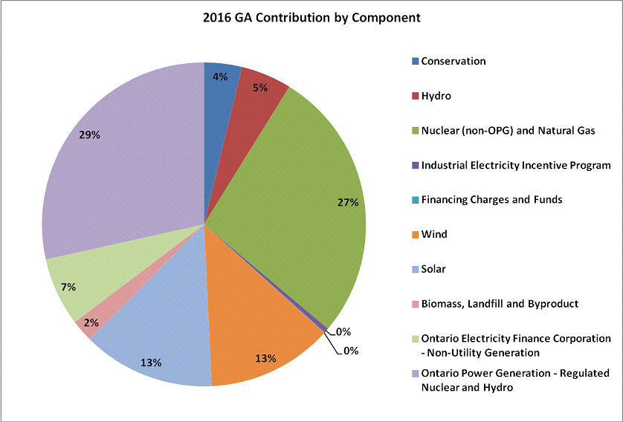
Global Adjustment
In 2016, the GA totaled $12.3 B
  Nuclear represented 61% of TWh produced and 41% of GA, while wind/solar represented 7% of TWh produced but 26% of GA

Slide 7
Overview of FHP
As contemplated, the FHP is premised on generation contracted for 20 years actually lasting for 30 years, allowing the recovery of the investment to occur over a longer period, thus “smoothing” the GA and customer bills.
25% Decrease
Increase at Inflation
Straight-line Increase
Amortization Period

Slide 8
Financing Structure
To implement contemplated GA smoothing, a trust would be established by OPG.
  The Trust would purchase a regulatory asset from the IESO and the IESO would use the proceeds to reduce the GA.
  The Trust would finance the purchase of the regulatory asset and receive a right to collect funds from ratepayers over the long-term to repay the financing.
OEFC
Capital Markets
Equity
Injection (44% of GA funding requirement)
$1.1 B
$0.1 B
5% of GA funding requirement
OPG
Ratepayers via LDCs
Sub Debt 49% of GA Funding Requirement
Reduced GA payment
$1.2 B
$9.6 B
Global Adjustment Payment to Generators & Other Industry Participants
SPV/Trust
$2.5 B
IESO
$12.1 B
GA Funding
Regulatory Asset
Senior Debt 51% of GA funding requirement
$1.3 B
2017 $2.5 B illustrative GA Funding
Capital Markets

Slide 9
Funding Alternatives
 | Short Term Funding – “Indicative Range 2-3%” |  | Long Term Funding – “Indicative Range 4 %to 5%”
 | 1) ABCP Conduit | 2) Bank | 3) Canadian Term ABS | 4) Canadian Bond | 5) U.S. Term ABS
Market | Canada | Canada | Canada & U.S. (with 144A wrap) | Canada | U.S.
Annual Market Capacity (Largest Issuers) | C$2bn+ for a syndicated facility | Up to C$2.5bn+ syndicated facility | Aggregate C$1.5bn+ subject to structure (amortizer, bullet, tenor) | C$2bn+ in fixed rate bullet bonds | US$4bn+
Frequency and Potential Size | Monthly up to the commitment amount of $1-2bn | Monthly drawdown with repayment from the capital markets | 2-3 times annually for an aggregate of C$1.5bn+ | 2-3 times annually for an aggregate of up to C$2bn | 2-3 times annually for an aggregate of C$4.0bn+
Duration | Renewable committed warehouses (commitments typically 1-2 years) Amortizing term-outs (WAL typically <4 years) | Up to 5 years, annually extendible | Bullet bonds up to 10 years are typical Long tenor capacity to be explored | Fixed up to 30 years Flexibility of tenors | Typically, amortizing assets are match-funded with amortizing debt
Rate | Floating | Floating | Fixed or Floating | Fixed or Floating | Fixed
Rating Requirement/Agencies | R-1 (high)/ P-1 ratings from DBRS and Moody’s Conduit RAC² | None required | AAA ratings from at least two of DBRS, Moody’s, S&P or Fitch Issue rating | Two ratings from two of DBRS, Moody’s or S&P Issuer or issue rating | AAA ratings from at least two of S&P, Moody’s or Fitch Issue rating
Hedging Required | ✗ | ✗ | ✗ | ✗ | ✓
Feasibility | High | High, subject to structure and syndicate composition | High Long tenor capacity to be explored | High Not tested in Canadian Market | High/Medium
² Rating Agency Confirmation

Slide 10
Debt & Cash Flows
Senior debt Tranche A: External markets
Subordinated Tranche B: OPG funded by equity
Subordinated Tranche C: OPG funded by 50/50 debt and equity

Slide 11
Impact on OPG
Illustrative Impact on OPG’s Base Case
OPG Net Income would increase due to incremental interest income while Return on Equity would reduce due to shareholder equity infusions
Magnitude of impacts dependant on legislative structure and future rate decisions
OPG may achieve additional qualitative benefits in parallel with the implementation of the trust

Slide 12
Status and Next Steps
Legislative Changes – Ministry of Energy (MOE)
Financing Process – OPG, IESO
Equity Injection Process – OPG, MOE, Ministry of Finance (MOF)
IESO and Trust Operational Process – OPG, IESO
Debt Issuance (General Planning) – OPG, MOF
Debt Issuance (Subordinated) – OPG
Debt Issuance (Short Term) – OPG
Debt Issuance (Long Term)– OPG
Recovering Interest, Administration and Other Financing Costs from IESO – OPG, IESO
Paying Interest, Administration and Other Financing Costs to Providers – OPG, IESO
Recovering Principal from IESO – OPG, IESO
Accounting Requirements and Process – OPG

Slide 13
APPENDIX

Slide 14
FHP Details
Rural or Remote Rate Protection (RRRP) to be expanded to provide distribution charge relief to ~800,000 customers up from the current ~350,000;
The Ontario Electricity Support Program to be expanded to provide an additional $180 -$276 per year for eligible households;
An Affordability Fund to be created for customers who do not qualify for low-income conservation programs and who are unable to undertake energy efficiency improvements without financial assistance; and,
On-reserve First Nations customers to receive a 100% credit of the delivery line on their monthly electricity bills.
For industrial customers, the Industrial Conservation Initiative program is to be expanded by reducing the eligibility threshold to 500 kW.
The plan contemplates legislation to enable the IESO and OPG to work together to refinance the Global Adjustment over a longer period of time. The legislation would also outline the role for the OEB, as it relates to the financing proposal.
The plan indicates that the next LTEP will require future procurements to be focused on outcomes, rather than contracting with specific technologies in order to foster innovation, create competition and lower the cost of electricity supply.
The plan expects the OEB to identify opportunities for cost efficiencies by encouraging shared partnerships on services between utilities, review its regulatory requirements to reduce red tape and eliminate costs, and look at opportunities to further drive transmission and distribution efficiencies and productivity improvements, including the use of innovative technologies and business processes.

Slide 15
Global Adjustment Actuals 2016
2016 GA Components | 2016 $M | %
Conservation | 467 | 4%
Hydro | 623 | 5%
Nuclear (non-OPG) and Natural Gas | 3,371 | 27%
Industrial Electricity Incentive Program | 60 | 0%
Financing Charges and Funds | (6) | 0%
Wind | 1,552 | 13%
Solar | 1,630 | 13%
Biomass, Landfill and Byproduct | 278 | 2%
Ontario Electricity Finance Corporation - Non-Utility Generation | 842 | 7%
Ontario Power Generation - Regulated Nuclear and Hydro | 3,516 | 29%
GA Total by Components | 12,333 | 100%

