Slide 1
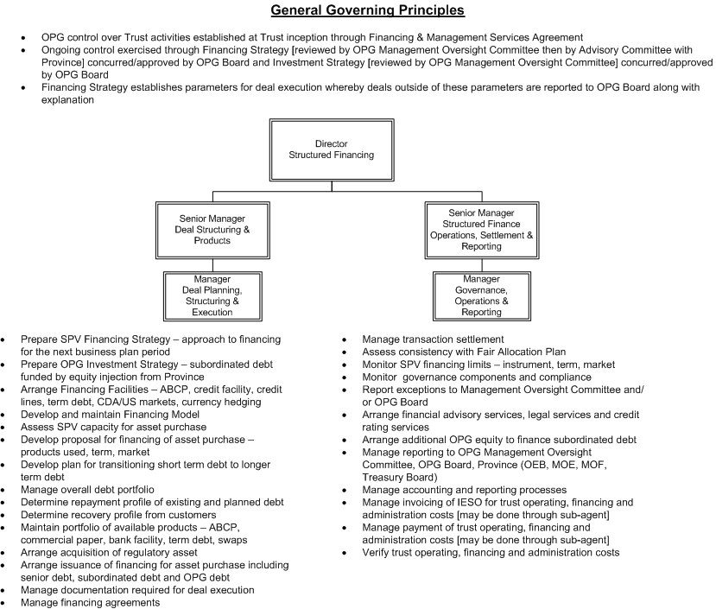
Organization Chart for unit responsible for supporting Fair Hydro Trust

