Slide 1
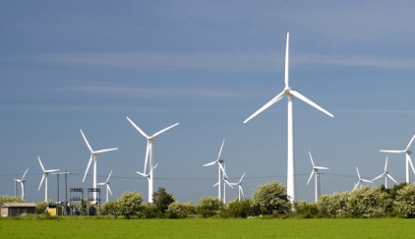
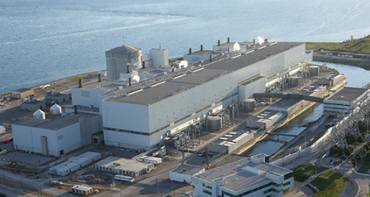

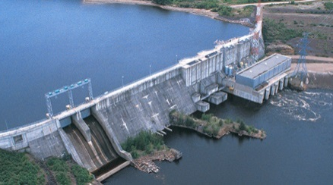




Fair Hydro Plan Financing Program
Rating Agency Presentation
July 6, 2017

Slide 2
Table of Contents
Ontario Electricity Market
Fair Hydro Plan
Financing Strategy
Transaction Structure

Slide 3
Executive Summary
logoRBCCM1
Capital Markets
0
CoverPageAddedID
Purpose
    To provide high-level overview of what is being contemplated by Ontario’s Fair Hydro Plan and related financing
    This presentation is based on the legislation and regulations in place and anticipated contractual arrangements
To explore both securitization and traditional structured corporate bond ratings
  Various financing alternatives are being explored, most of which have potential rating agency involvement
To set expectations for timing and process
Brief Overview
    On March 2, 2017 Ontario announced its Fair Hydro Plan which proposes to lower the average residential electricity bill by 25%
  25% reduction includes the 8% rebate introduced in January 2017 as part of the Ontario Rebate for Electricity Consumers Act, 2016
  The 25% reduction is expected to be in effect until 2021 (approximately 4 years) although bills may be allowed to increase by the rate of inflation
The 17% incremental reduction as part of the Fair Hydro Plan will be recorded as a regulatory deferred asset for future recovery
  The recovery period depends on the final fair allocation but is expected to begin in 2027 with a hard stop in 2047
The exact quantum and duration of the program is still being developed, but the deferral is expected to amount to ~C$2.5bn / year
  It is expected that 50+% of the financing will be derived from the capital markets
Legislation to effect the recovery right was enacted in early June, and the regulations were largely completed at the end of June
  Legislation and regulations were designed with capital market financing objectives in mind
  Careful consideration given to possible structural enhancements with respect to creating the regulatory asset, assignability, achieving a true-sale opinion, being non-bypassable and including a true up mechanism to ensure repayment
Ratings Objectives
Initially we are reaching-out to better understand what methodologies you will apply to this program / structure
Ultimately, we will be pursuing some combination of ABCP conduit rating confirmation, and/or explicit long-term ratings for the credit facility, term debt and sub-debt

Slide 4
Transaction Parties
logoRBCCM1
Capital Markets
0
CoverPageAddedID
Issuer | Fair Hydro Trust (“FHT”)
Advisors | CIBC, Goldman Sachs, RBC
Financial Services Manager | Ontario Power Generation (“OPG”) is 100% owned by the Province of Ontario (the “Province”) | A low (DBRS), BBB+ (S&P)
Servicer | Independent Electricity System Operator (“IESO”) | A high (DBRS), Aa2 (Moody’s)
Provincial Rate Authority | Ontario Energy Board (“OEB”)
Guarantor | Province of Ontario (the “Province”) | AA low (DBRS), AA- (Fitch), Aa2 (Moody’s), A+ (S&P)
Issuer’s Counsel | Torys LLP (Canada), Hunton & Williams LLP (U.S.)
Advisor’s Counsel | Osler, Hoskin & Harcourt LLP (Canada, U.S.)
Timeline
    Deferral started in June 2017
    Warehouse financing to begin as soon as possible
    Currently educating agencies and seeking to better understand applicable criteria / methodologies
July 2017
S | M | T | W | T | F | S
 |  |  |  |  |  | 1
2 | 3 | 4 | 5 | 6 | 7 | 8
9 | 10 | 11 | 12 | 13 | 14 | 15
16 | 17 | 18 | 19 | 20 | 21 | 22
23 | 24 | 25 | 26 | 27 | 28 | 29
30 | 31
August 2017
S | M | T | W | T | F | S
 |  | 1 | 2 | 3 | 4 | 5
6 | 7 | 8 | 9 | 10 | 11 | 12
13 | 14 | 15 | 16 | 17 | 18 | 19
20 | 21 | 22 | 23 | 24 | 25 | 26
27 | 28 | 29 | 30 | 31
Key Dates
Select Rating Agencies
Complete Ratings Process
Market Holidays
Canadian
U.S.

Slide 5
Ontario Electricity Market
sectionRBCPageID
SECTION I

Slide 6
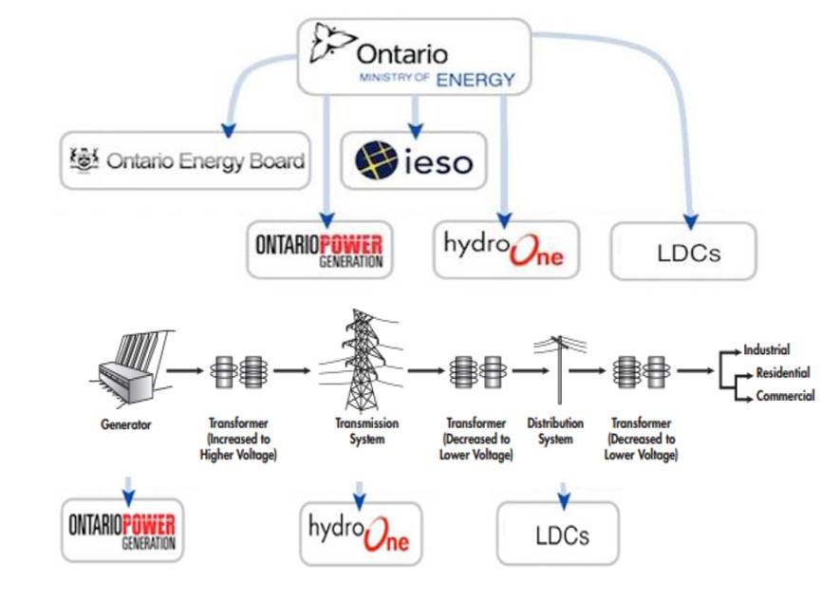
Overview of the Electricity Market in Ontario
The Ontario electricity market is highly regulated
Transmission rates, Distribution rates, and OPG’s Generation are set by the Ontario Energy Board
Rates for the majority of the remaining generation are set by direct contracts with the IESO (e.g. Bruce, Wind / Solar Power)
Key Entities
The Ontario electricity market has $22B in annual cash flows
Ontario Ministry of Energy | Sets policy for the electricity system
Ontario Energy Board | Ontario Energy Board is Ontario’s independent energy regulator that evaluates rates paid to regulated energy providers The Ontario Energy Board has a statutory obligation to set the regulated electricity price for Regulated Price Plan (RPP) consumers
IESO | The Independent Electricity System Operator manages the operation and reliability of Ontario’s bulk power system and administers the wholesale electricity market
OPG | Ontario Power Generation is Ontario’s largest electricity generator, producing approximately half of Ontario’s electricity Wholly owned by the Province of Ontario
Hydro One | Owns and administers transmission in the province
LDC’s | Local Distribution Companies (LDC’s) provide power to end-users (residential / commercial / industrial) There are 60+ LDC’s operating in the IESO market; the 3 largest LDCs⁽¹⁾ account for ~60% of Ontario’s 5.1 million customers
Hydro One, Toronto Hydro, and Alectra

Slide 7


Flow of Funds Through Key Market Participants
Local Distribution Companies (LDCs) buy power on behalf of their rate base (primarily residential & commercial)
IESO collects monies from LDCs on behalf of generators (eg. OPG) and transmitters (eg. Hydro One); rates for power and transmission are set by IESO contracts or the OEB
Key buyers of power are LDCs and directly connected industrials; buyers purchase their requirements through the IESO
Customers
LDCs
Transmission
Alectra
Residential & Other
Toronto Hydro
IESO
Generators
Other LDCs
Market is overseen by the Independent Electricity System Operator – provincial agency that acts as a coordinating body to ensure enough power is generated to meet demand
Other Participants
Large Industrial

Slide 8
The IESO
Key Credit Strengths
The IESO is at the center of the market, as buyers purchase power from the IESO and sellers of power are paid by the IESO
IESO is effectively a clearing house and establishes the terms by which buyers are able to purchase power
IESO Market Rules - Chapter 2 of the Market Rules outlines the parameters for Participation or “the procedures pursuant to which persons may apply to the IESO for the authorization to participate in the IESO-administered markets or to cause or permit electricity to be conveyed into, through or out of the IESO-controlled grid”
The credit conditions are outlined in Chapter 2 and involves the “prudential support” provided by the LDC
Based on public credit ratings or credit payment history, a buyer of power may be required to post collateral to support their projected exposure; LDCs, given their strong credit structure are awarded higher unsecured purchase limits
The Prudential Rules are reviewed every few years and maintain a conservative stance regarding collateral
Strong Credit History
Approximately $22 billion in costs flow through the Ontario electricity system each year (60% goes to generators)
Since the beginning of the IESO open market in 2002, there have been 20 defaults
Only three defaults could not be fully covered by the collateral posted by the defaulters
Of the three defaults that resulted in “default levies” to the market participants, the total the levies were under $1 million
Default levies are allocated 50% to Buyers of Power and 50% to the Sellers of Power, based on their usage/generation

Slide 9
LDCs
Key Credit Strengths
The majority of power purchased in Ontario is by LDCs on behalf of residential and commercial customers; LDCs make up approximately 80% of the market
The typical customer bill includes charges for the power itself (which goes to the generators), transmission (e.g. Hydro One), to the LDC itself (for local distribution), and for other market charges (e.g. IESO costs)
LDC rates are governed by the OEB rate setting process; LDCs under the OEB’s Retail Settlement and Distribution System Code may obtain a security deposit or letter of credit from their customers to mitigate risk of payment default
LDCs are able to include an amount for accounts receivable write-offs within operating expenses for rate setting purposes. They can also apply for any extra-ordinary write-offs as a variance account adjustment to be considered by the OEB
Approximately 10 LDC’s have credit ratings through DBRS or S&P; the ratings are generally A, based on very low industry risk of regulated utilities and supportive regulatory framework;
The OEB deems the capital structure of a LDC to include 40% equity and sets an allowed rate of return
Strong Credit History
Given the strong credit mitigation measures available to the LDCs, a review of 8 LDCs (varied in size and geographic region), indicated a similar and very low loss rate
LDC data was based on the financial statements of Toronto Hydro, North Bay Hydro, Horizon Utilities, Enersource, Collus PowerStream, Energy Plus, PowerStream, and Hydro One
 | Average | Last 5 Years Average
AFDA / AR | 3.40% | 3.70%
AFDA / Sales | 0.42% | 0.44%
Write-Off / Sales | 0.29% | 0.28%
AFDA: Allowance for doubtful accounts

Slide 10
Fair Hydro Plan
sectionRBCPageID
SECTION II

Slide 11
Background
On March 2nd the Ontario Government Announced its Fair Hydro Plan
The plan proposes to lower the average residential electricity bill by 25 percent
In part by reallocating the charges paid by ratepayers for generation contracts and conservation programs over an extended period to match the expected life of the assets and the benefits of these initiatives
In order to reallocate the payments, an OPG managed Financing Entity will use debt to purchase Regulatory Assets from the IESO and amortize them over a longer period
This will lead to a near-term reduction in electricity bills followed by an increase in electricity bills over the long-term as interest and principal is repaid
The government has further committed to capping the increase on the average residential bill at the rate of inflation for three years following the initial year
Financing Entity Overview
OPG has the mandate to create and oversee a Trust separate from regular operations, that will finance costs related to the Fair Hydro Plan and spread the recovery through 2047
The OEB will set the Regulated Price Plan to meet the requirements of the Fair Hydro Plan
The IESO will create a regulatory asset approximately equal to the difference between collections from ratepayers and payment obligations to generators and conservation
The Trust will have the right, but not the obligation, to purchase these regulatory assets / investment interests to support the debt required
  Upon purchase by the trust, the regulatory asset becomes investment interest for the trust
The Trust will enter the capital markets 1-3 times per year to secure long-term investment interests
Given the province’s commitment to reduce electricity bills, there is a requirement to establish a financing entity, the “Trust”, that will finance the shortfall in revenues not received from the market

Slide 12
Regulatory Asset / Investment Asset
Regulatory Asset
IESO has authority under the Act to create a variance account to track the regulatory asset and is able to recover the balance in the variance account from consumers
The OEB will set rates in accordance with regulation to recover the variance account balance through the clean energy adjustment but the OEB cannot change the amount of the clean energy adjustment to be recovered
IESO is not able to recover the variance account balance prior to May 1, 2021
IESO can transfer a portion of the variance account / regulatory asset to a financing entity
A transfer of the variance account / regulatory asset is treated as an absolute sale of the IESO’s right to recover the balance [and is not simply a security interest]
Investment Asset
Transfer of the regulatory asset to a financing entity becomes an investment asset in the financing entity
The investment asset constitutes an irrevocable property right and interest consisting of all rights of the IESO with respect to the variance account including the right to determine, impose, invoice, and collect the clean energy adjustment
Investment interest owner can grant a security interest in order to secure a funding obligation

Slide 13
Addition of the Trust
In order to facilitate a ratepayer discount, the Trust is introduced to pay the difference to the IESO
Customers
LDCs
Trust
Transmission
Alectra
$ (covers reduction)
$ (repayment)
$ (reduced)
$ (increased)
IESO
Generators
Residential & Other
Toronto Hydro
Other LDCs
Other Participants
Large Industrial

Slide 14
Financial Services Manager - OPG
The Fair Hydro legislation names OPG, as the Financial Services Manager
Why OPG
One of the most experienced and largest generating companies in Canada, OPG has a broad set of relationships and capabilities that make it a valuable resource to the Province of Ontario
Experienced in successful complex financing arrangements of large capital projects (such as OPG’s recently completed Lower Mattagami project)
OPG’s Role as Financial Services Manager
Prepare a Financing Plan to evaluate whether potential funding obligations should be incurred for the purposes of acquiring an investment asset
Administer the investment asset on behalf of the financing entities
Ensure that funding obligations are incurred in a manner that is consistent with the Financing Plan
Establish and charge fees for Financial Management Services
Shall not provide for funding obligations to be incurred with any recourse to any assets of an electricity vendor, OPG, the OEB, the Province or the Lieutenant Governor in Council

Slide 15
Flow of Money between Trust and IESO
Province
Capital Markets
OPG
Ratepayers via LDCs
49%
Sub-debt
Reduced payment
Payment for deferral
Payment to Generators & Other Industry Participants
Trust
IESO
51%
Senior Debt
Future Trust repayment
Capital Markets Debt
Bank / ABCP Conduit
ABS / Bonds
  Warehouse
  Term Financing

Slide 16
Simplified Trust Structure
The Fair Hydro Trust will fund regulatory asset purchases through the issuance of senior and subordinated secured debt
  Senior debt (51%) will be sourced monthly from committed warehouse facilities (bank and / or ABCP), and the periodic issuance of term debt
  Subordinated debt (49%) will be provided by OPG; 44% of which will be obtained from an OEFC equity injection and 5% from OPG via external markets
  Senior and subordinated principal will be scheduled to amortize to maintain the original proportions, shortfalls to be allocated first to the subordinated debt
Senior Debt 51%
Senior Debt (Public Markets)
Accessed from:
Canadian Securitization Program
U.S. Market Program
Subordinated Debt 39%
Subordinated Debt
Provided to Trust by OPG via Ontario government
Junior Subordinated Debt 10%
Junior Subordinated Debt
OPG Injection (5%)
Province to Trust by OPG via Ontario government (5%)

Slide 17
Financing Strategy
sectionRBCPageID
SECTION III

Slide 18
Financing Strategy – Funding Alternatives
logoRBCCM1
Capital Markets
0
There are several potential funding sources that OPG can consider to structure the overall financing program, including securitization (issued in Canada or the U.S.), bonds, bank financing, and subordinated debt
Warehouse financing (ABCP or bank debt) and OPG sub-debt will be used to fund monthly investment asset purchases from the IESO (monthly IESO funding shortfalls anticipated to be ~$200 million)
  Fair Hydro Trust will periodically refinance the warehouse facility through the issuance of term debt
It is anticipated that the first term debt takeout will be completed in the fall of 2017
  Aggregate financing for the first offering could be ~$400 - $600 million, with senior-debt of about $200 - $300 million
Both Canadian and U.S. term debt markets will be considered but decision on which markets to access will be determined on a deal by-deal-basis
Term debt can take the form of bullet bonds or could be issued as amortizing bonds
ABCP Conduit | R-1(high) rating confirmation will be required from DBRS pre-closing Used to fund monthly regulatory asset purchases from the IESO
Bank | Two explicit long-term ratings will be required Used to fund monthly regulatory asset purchases from the IESO
Canadian Term ABS / Bond | Two explicit long-term ratings required; AAA rating will be targeted
US Term Debt (ABS / Bonds) | Two explicit long-term ratings required; AAA rating will be targeted Requires cross-currency swaps
Subordinated Debt | Subordinated notes will provide credit enhancement for senior debt (ranks behind senior debt in cash flow waterfall) Two explicit long-term ratings required

Slide 19
Indicative Waterfall
Taxes, Trustee Fees & Operating Expenses (to lawyers, accountants, IESO, rating agencies, etc.)
Interest on Senior Notes
Scheduled Principal – Senior
Replenishment of Reserve Accounts
Allocation of Collections
Financial Services Manager fees (OPG)
Interest on Subordinated Notes
Scheduled Principal – Subordinated
Interest on Junior Subordinated Notes
Scheduled Principal – Junior Subordinated
Excess Funds Account (amounts available for next payment period)

Slide 20
Illustrative Trust Debt Balance: Borrowing and Repayment

Slide 21
Transaction Structure
sectionRBCPageID
SECTION IV

Slide 22
Structural Comparison
 | Precedent Utility Charge Securitizations | Proposed Fair Hydro Structure
Legislation | Legislation creates regulatory basis for implementation and servicing of the charge
Details of Financing | Outlined in irrevocable Financing Order | Outlined in Regulations supported by province guarantee
Collateral | The right to impose and collect a charge from electric utility customers as well as transaction reserve accounts
Government Support | State pledge not to permit any action that would impair the value of the Collateral | Province guarantee of repayment if any action taken that would impair the value of the Collateral
Non-Bypassability | Charge to be paid by all existing and future electric customers in included customer classes
Impacted Customers | The majority of customers in service territory (including residential, commercial and industrial) | The majority of customers are residential and light commercial
Recovery Charge | Relatively low, <5% of total bill | Approximately 10% of total bill
Issuer | Varies, but generally a newly formed special purpose vehicle (“SPV”) that is a subsidiary of Investor Owned Utility | Newly formed special purpose vehicle (“SPV”) would be consolidated into Ontario Power Generation (“OPG”) financial statements
Servicer | Varies, but generally Investor Owned Utility | Independent Electricity System Operator (“IESO”)
Third Party Billing | Varies depending on State | Yes, via Local Distribution Companies (“LDC”)
Nonpayment & Partial Payment by Customers | To the extent that any electric utility customer makes a partial payment of a bill containing the charge, the charge collection will be a pro-rata portion of the payment
Amortization | Fully amortizing with principal payments beginning at first issuance | Bullet or amortizing bonds with principal payments deferred for a number of years following issuance
Establishment of First Charge | Generally within 1 year of issuance | Delayed start
Credit Enhancement | True-up mechanism, reserve accounts | True-up mechanism, reserve accounts, and subordinated debt
Hedging | Historically limited to interest rates | May include interest rate and currency hedging
Trust Structure | Discrete (single issue) trust | Master trust with multiple series issued over a 10 year period
Legal Opinions | Standard opinions regarding Validity, Enforceability and Regulatory Issues (Constitutionality opinion not applicable for Canadian transactions)

Slide 23

Transaction Includes Same Key Elements as ‘AAA’ Investor-Owned Utility Securitizations
Based on the existing Ontario Electricity market infrastructure no credit losses are anticipated
Fair Hydro Trust true-up mechanism will ensure timely and full collectability of all debt
OPG subordinated debt will provide incremental credit enhancement for the senior debt
Provincial guarantee protects investors from an adverse change in law or inability to fund in capital markets
The Province of Ontario has very low credit risk and is considered to be stable
  High likelihood of Government of Canada (Aaa, stable) actions to prevent provincial default
  Ontario is the largest economy of Canadian provinces: 40% of national economic output, 38% of national population, strong destination for immigration, lower than national unemployment rate
 | Experienced Operating Agent | OPG, IESO, and LDC are experienced operators
 | Strong Service Territory | Stable customer base with diversified service territory
 | Enhanced True-up | Mandatory semi-annual true-ups to correct for any over or under collections Optional interim adjustments permitted as necessary
 | Irrevocable & Nonbypassable Charge | Final and effective upon issuance of Bonds Applies to all residential and small commercial consumers receiving power through T&D system
 | No “Cap” on Collection of Charge | No limits on collection of charge that may be imposed on all customers after moratorium period
 | Province Guarantee | Strong government support through guarantee of bond legal and regulatory framework
 | Full Cross-Collateralization | Any collection shortfall is allocated among all specified consumers
 | No Industrial Risk | No single large customer or industry exposure

Slide 24
Legislative and Regulatory Overview
Authorizes Use of Securitization and Establishes Servicing Relationship between OPG, IESO and LDCs
General Powers and Authority of Legislation | Responsibilities Under New Structure
Creation of mechanism for deferral of costs by the IESO and establishment of the Regulatory Asset Creation of mechanism for absolute sale of Regulatory Asset to Financing Entity Definition of impacted customers (“specified consumers”) Establishment of right to bill and collect a non-bypassable clean energy adjustment from future specified consumers Establishes principles of the Financing Plan Statement of non-impairment by the Crown and provision for a Provincial Guarantee Allowance for the establishment of a bankruptcy-remote issuer Allowance for true-up mechanism
Fair Hydro Regulations
Details on calculation of the fair allocation amount Details on eligible financeable amounts Additional details on clean energy adjustment assessment methodology (true-up mechanism): Timing (mandatory semi-annual + more frequent as needed) Calculation (accounts for expected charge-offs, billing delays and usage as well as any under / over collection in previous period) Additional details around servicing / billing mechanics (e.g., LDCs and IESO)
OPG
    OPG to act as Financial Services Manager including the development and implementation of the Financing Plan
    Calculates the clean energy adjustment including semi-annual true-up
IESO
    Establishment of IESO as Servicer
    Aggregation of collections by LDCs and remittance to Trustee
LDCs
    Manage the billing and remittance of the non-by-passable charge
    Includes charge as a separate line-item on customer bills
Ontario Energy Board
    Must accept clean energy adjustment, and converts to customer charge
    Allow for the charge to go into effect
    Review / approve ongoing Financial Services Manager fees and expenses

Slide 25
Objective of the Legislative, Regulatory and Contractual Structure
    Due to the number of related parties participating in the transaction an overarching theme of the structure is to establish the transaction on a commercial basis
    OPG expects to consolidate the results of the Trust in its financial statements based on the commercial relationship between OPG and the Trust
    The commercial basis is established by a number of elements which work together
  Trust has the right but not the obligation to purchase a Regulatory Asset
  Regulatory Asset purchased by the Trust provides the right to bill and collect a charge from future consumers
  Transactions in the Trust to finance the asset purchase to be on an arm’s length basis
  Amount collected from consumers includes costs of financing the asset purchase, costs to manage the financing, costs to operate the Trust and repayment of principal
  OEB role established to support recognition of asset and customer charge
  Debt of the Trust structured to balance risk and cost with objective to achieve highest rating possible
  Subordinated debt issued by the Trust will be rated and will price off of the senior debt based on a survey of banks
  Subordinated debt will absorb uncertainties of the senior debt to support highest rating of the senior debt
  OPG will manage the activities of the Trust for a fee comparable to fees charged by 3rd party managers. OEB role will be limited to reviewing the application of the fee methodology
    Notwithstanding consolidation of the Trust into OPG the Trust will be structured to be bankruptcy remote from OPG

Slide 26
Bill 132 Fair Hydro Plan Act, 2017 Legislation
The Act establishes a framework under which the costs and benefits associated with the “clean energy initiative” are to be allocated among present and future consumers of electricity
Rate Reduction Time Period
    From July 1, 2017 until April 30, 2019, electricity rates payable by a “regulated rate consumer” will be the rate that would result in a representative regulated rate consumer who meets the prescribed criteria being charged an invoice amount that is 25% less than the regulated rate that would otherwise have been determined by the OEB
  For the 12 month period beginning May 1, 2018 the invoice amount established previously would increase by the rate of inflation in Ontario
  Subsequent rate reductions beyond April 30, 2019 will be established by regulation
Regulatory Asset
Each month, the IESO will determine the shortfall resulting from the rate reduction and record in a variance account. IESO has the right to recover the balance recorded in the variance account from specified consumers and this right will be a “regulatory asset” under the Act. IESO will not be entitled to collect the balance recorded in the variance account from specified consumers before May 1, 2021
Investment Asset
IESO may transfer (sell) a specified portion of the regulatory asset to the financing entity established by OPG. The Trust is not obligated to purchase the asset. Upon the transfer, the financing entity acquires an interest in the investment asset that is a current and irrevocable property right consisting of the right to impose, invoice, collect, receive and recover the clean energy adjustment from specified consumers or electricity vendors
Components of the legislation and accompanying agreements that are of interest to investors
Investment assets created by the IESO represents a claim on the rate-payers that is a current and irrevocable property right consisting of the right to impose, invoice, collect, receive and recover from the market
The trust is not obligated to purchase the regulatory asset from the IESO
The various investment assets are pari passu
The province is providing a guarantee to the trust; backstopping its obligations, either if there are changes in future legislation or if there are market disruption (liquidity) issues

Slide 27
Clean Energy Adjustment – Proposed Billing and Collection Process
logoRBCCM1
0
Capital Markets
Clean Energy Adjustment amounts for billing and collection purposes will be managed outside of the IESO’s current settlement processes set out in the Market Rules for electricity invoice amounts
  As such, CEA amounts will not benefit from the rights the IESO currently has under the Market Rules – ability to charge interest, draw down on prudential amounts, and borrow to cover shortfalls
  Collections risk for CEA amounts are dealt with through statutory rights in the Act, the collection obligations of the IESO under the Master Sales and Services Agreement (to be finalized) and the ability to include amounts into the true up mechanism
1
Financial Services Manager
Determines the CEA (monthly) based on legislation and regulation and notifies the OEB of CEA for each reference period
2
OEB
Determines volumetric rates¹ to invoice specified consumers to recover CEA expressed as a cent per kWh
3
Electricity Vendors
Invoice specified consumers for CEA amount by using volumetric rate set by OEB and report the amount invoiced and collected from consumers to the IESO
4
Specified Consumers
Must pay invoice from Electricity Vendors for CEA amount
5
Electricity Vendors
Must collect CEA amounts from specified consumers, hold amounts in a segregated account and remit CEA amounts to the IESO (separate from any other amount collected and remitted)
6
IESO
Must receive CEA amounts paid by Electricity Vendors, hold CEA amounts in a trust and remit the CEA amounts to the financing entities
¹ The rates will be determined by dividing the CEA amount by the forecasted energy consumption in the reference period by specified consumers

Slide 28
Indicative Allocation of Servicing Role and Responsibilities
 | OPG / Financing Entity | IESO | LDC
Management of Ongoing Issuance | 
Meter Reading |  |  | 
Billing |  |  | 
Collections |  |  | 
Cash Management |  | 
Remittance of Charge to Trustee |  | 
(Responding to inquiries by customers if practicable, or forwarding such inquiries to OPG) |  |  | 
Ongoing Filings for Trustee and Rating Agencies | 
True-Up Calculation |  | 

