Slide 1
Ontario’s Electricity Bills:
Current Requirements and Long-Term Improvements
July 2017

Slide 2
Contents
Overview of Electricity Bill Requirements
Ontario’s Fair Hydro Plan (OFHP)
Redesign Action Plan (RAP)
Hydro One – Bill Redesign Initiative
Proposed Timeline

Slide 3
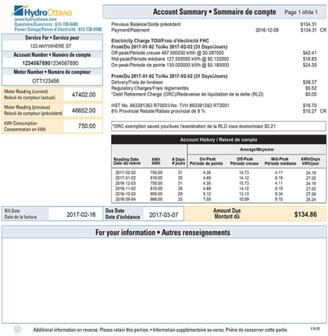
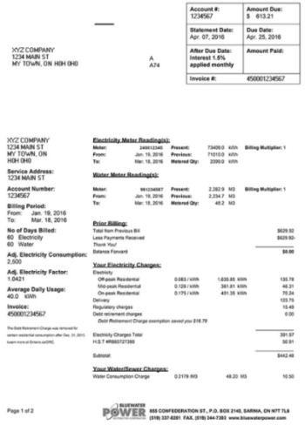
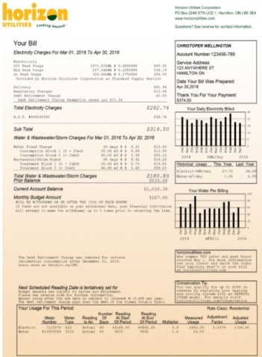
Electricity Bill Requirements – Authority Overview
In Ontario, most electricity customers receive bills for their consumption of electricity from their Local Distribution Company (LDC).
The government has the authority to stipulate requirements in relation to the form and content of electricity bills, including the ability to prescribe messaging related to government programs directly on bill invoices, inserts and envelopes.
  The government obtains its authority to mandate specific content with respect to bills from the Ontario Energy Board Act, 1998 and there are a number of regulations requiring LDCs to display messaging in a certain way on electricity bills.
These requirements have been criticized as a patchwork of measures that limit the invoice’s readability and usefulness to consumers. Customer advocates have called for more flexibility to design a more consumer-responsive invoice.
Outside of these requirements, LDCs enjoy the flexibility to present their bills in a manner which they believe best responds to the preferences of their customer base, causing bill appearance to vary widely across Ontario’s approximately 70 LDCs (see right).

Slide 4
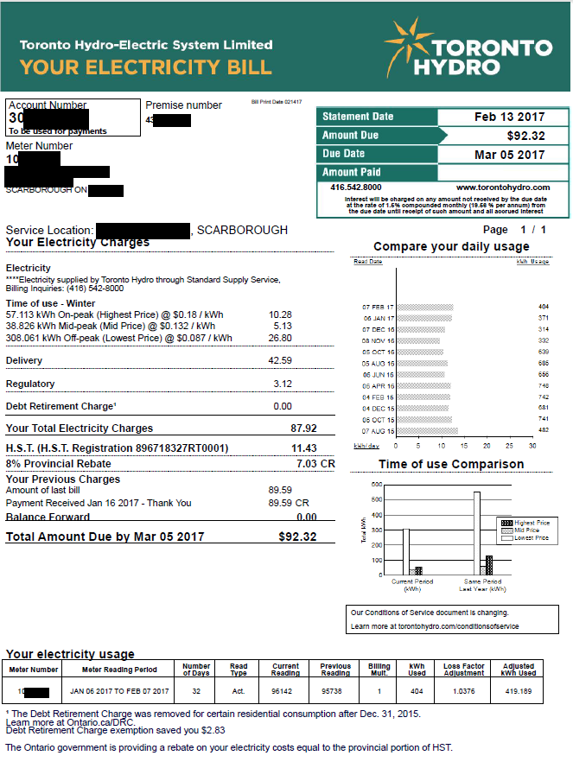
Bill Example – Front
Statement Date, Policy on Due Date
OEB Codes
Phone & Website Contact O. Reg. 275/04
Heading
O. Reg. 275/04
Price & Consumption Breakdown must follow “Electricity” Sub-heading
O. Reg. 275/04
Policy on Applicable TOU Price and Period
OEB Codes
Sub-headings
O. Reg. 275/04
Historical Use Comparison
O.Reg. 275/04
- Not required in graphic form
- No specific requirements re: the length of historical comparison period
8% Rebate
O.Reg. 364/16
Policies on Late Charges, Balance Forward, Deposits, Total Amount Due, etc
OEB Codes
Actual Meter Read O. Reg. 275/04

Slide 5
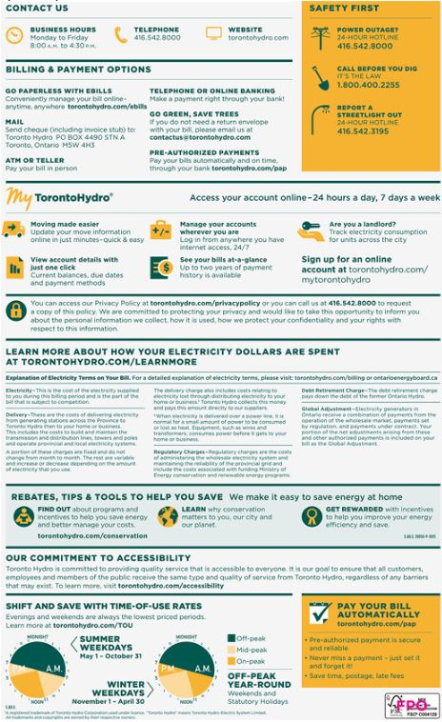
Bill Example – Back
Policies on Forms of Payment
OEB Codes
Website links for where to get more Information in Prescribed Language O. Reg. 275/04
Explanation of Electricity Terms in Prescribed Language
O. Reg. 275/04
TOU Prices and Periods
OEB Codes

Slide 6
Ontario’s Fair Hydro Plan – Billing Requirements
On March 2, 2017, the government announced Ontario’s Fair Hydro Plan (OFHP), which will lower electricity rates for households and small businesses by an average of 25 percent starting in the summer of 2017.
To implement this plan, LDCs were required to make backend system changes to ensure that eligible residential customers received the applicable rebates and lower charges by the mandated deadlines (May 1, 2017 or July 1, 2017).
  LDCs were also required to make billing system changes such that electricity bills were updated to reflect OFHP initiatives and customers were informed about the resultant bill impacts.
Specifically, as of July 1, 2017, LDCs were required by regulation to:
  include standardized on-bill OFHP messaging;
  accompany paper invoices with a descriptive OFHP bill insert once per quarter for 12 months, beginning with the first invoice issued on or after July 1, 2017 until the first invoice issued on or after July 1, 2018; and
  include a "First Nations Delivery Credit" as a line item for on-reserve customers, as applicable.
In anticipation of these new requirements, the Ministry revoked outdated messaging from electricity bills to free-up space and reduce potential confusion amongst consumers. This included removing “8% Provincial Rebate” messaging from invoices and envelopes under O. Reg. 364/16, and DRC messaging under O. Reg. 275/04.
  LDCs were in favour of this regulatory “clean-up”, indicating they “maxed out” the available space on electricity bills.
Importantly, under these new and existing regulations, LDCs are able to petition the Minister, via a letter, to seek adjustments and/or exemptions from the invoicing requirements due to technical and/or operational limitations.

Slide 7

Ontario’s Fair Hydro Plan – Bill Insert

Slide 8
Redesign Action Plan (RAP)
Despite these recent changes, the Ministry recognizes there is an opportunity to further revise the regulatory framework on invoicing to improve the value of electricity bills to all consumers - ensuring they get the most out of their bills.
In pursuit of this effort, the Ministry plans to launch a Redesign Action Plan (RAP) this summer with the aim of improving electricity bills by achieving the following objectives:
    Enhancing the customer experience;
    Better communicating government initiatives and programs;
    Consolidating the regulatory framework; and
    Promoting greater understanding.
To initiate this plan, the Ministry intends to convene a “RAP Working Group” in August 2017 consisting of Hydro One, the Electricity Distributors Association (EDA), the Coalition of Large Distributors (CLD), as well as additional LDCs, the OEB and relevant industry associations to seek feedback on changes to bill presentment and invoicing regulations from the sector.
  This bill redesign could also consider how to display OFHP program savings more directly on consumer bills (e.g., providing a “personalized” message indicating how much customers saved as a result of the plan).
The Ministry also plans to conduct research on bill redesign initiatives, including a jurisdictional scan on best practices, as well as background on vendor billing systems.
Based on these efforts, the Ministry aims to prepare new regulations that would into effect Fall/Winter 2018, but include an ample transition period.

Slide 9
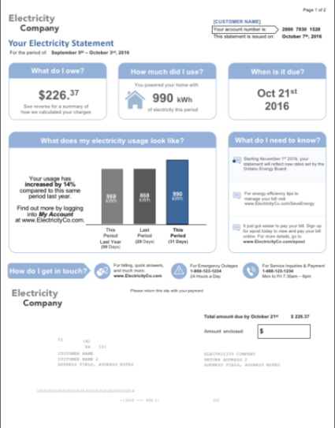
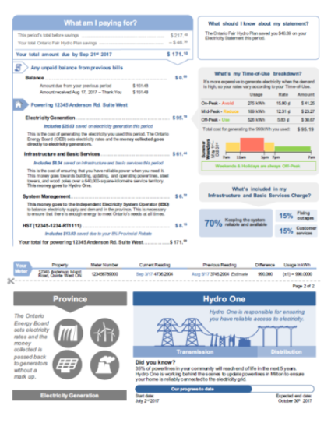
Case Study: Hydro One’s Bill Redesign Initiative
Hydro One has also been investigating ways to improve the appearance and comprehension of its bill, which has remained unchanged for over a decade.
Hydro One customers indicate their current bill suffers from: a lack of transparency, over-complicated language, overcrowded text, a lack of visual aids and a formal tone.
As part of this undertaking, Hydro One has enlisted the services of a behavioural research firm and engaged an online panel of 4,000 customers.
Utilizing this feedback, Hydro One has prototyped alternative bill designs which have been observed to increase customer satisfaction and comprehension, as well as improve attitudes towards LDCs and the electricity sector.
To facilitate the implementation of this redesign, the Ministry has provided Hydro One with an exemption from current invoicing requirements under O. Reg. 275/04, as well as specified OFHP invoicing requirements, as of July 1, 2017.
  This exemption will allow Hydro One to proceed with its planned bill redesign in Fall 2017, unencumbered by regulatory requirements.
  By mid-2018, Hydro One expects to provide 1.1 million customers with redesigned invoices.
In addition, Hydro One has agreed to participate in the Ministry's RAP Working Group; sharing its learnings from its bill redesign initiative.
Hydro One: Redesigned Bill

Slide 10
Proposed Timeline
In order to have new regulations in place for January 1, 2018, the Redesign Action Plan should be undertaken according to the following timeline:
Pre-July 1, 2017
OFHP Bill Inserts
July 1, 2017
OFHP Required Messaging
Aug. – Sept. 2017
RAP Consultations
Fall – Winter 2017
RAP Regulatory Amendments
Winter 2018 – RAP Implementation
Requirement for LDCs to issue “8% rebate” envelopes, and include “8% rebate” on-bill messaging revoked from O. Reg. 364/16.
LDCs voluntarily issue OFHP bill inserts in late June ahead of finalized OFHP regulations (inserts printed by ENERGY).
OFHP regulations introduced requiring LDCs to comply with the following by July 1st:
Issue prescribed OFHP bill inserts on a quarterly basis for one year;
Include standardized OFHP on-bill messaging;
Include a FNDC line item, where applicable; and
Remove outdated on-bill messaging (e.g., DRC exemption).
Hydro One exempted from O. Reg. 275/04 and specified OFHP invoicing requirements.
ENERGY to convene a RAP Working Group in August, including Hydro One, the EDA, the OEB, the Coalition of Large Distributors, as well as other LDCs and industry assoc.
ENERGY to seek feedback on changes to bill presentment, regulatory reform, and gather information on behavioural economics, consumer advocacy, and billing system design.
Following RAP consultations, ENERGY to introduce regulatory amendments to simplify bill presentment in late Fall/Winter 2017.
Hydro One to begin rolling out its redesigned electricity bills in Q4 2017.
New/amended invoicing regulations to become effective as of January 1, 2018.
Hydro One expected to complete its roll-out of redesigned bills to its low volume consumers by Q2 2018.
New regulations to include ample transition period for LDCs to adopt new regulatory invoicing requirements.

